Slide 1



Texas Project Delivery Framework and Quality Assurance Team (QAT)
December 4, 2013
J.J. Pickle Research Campus
Austin, Texas
Legislative Budget Board

Slide 2
Agenda Topics
Project Definition
Major Information Resources Project (MIRP)
1 Texas Administrative Code (TAC) 216
Quality Assurance Team (QAT)
Overview of MIRPs reported to QAT
Analysis of MIRP Projects
New Legislation
Texas Project Delivery Framework (Framework)
Framework Redesign Project
Interactive session: The Business Case Workbook

Slide 3
Project Definition
TEX GOV’T CODE §2054.003 (12) defines a Project as:
An initiative that provides information resource technologies and creates products, services, or results within or among elements of a state agency and is characterized by well-defined parameters, specific objectives, common benefits, planned activities, a scheduled completion date, and an established budget with a specified source of funding.
Project Management Body of Knowledge (PMBOK) defines a Project as:
A temporary set of activities designed to produce a unique product, service or result.
It is temporary in that it has a defined beginning and end in time, and therefore defined scope and resources.
It is unique in that it is not a routine operation, but a specific set of operations designed to accomplish a singular goal.
PMBOK defines a Program as:
Inter-related projects that produce an outcome or series of outcomes that benefit the business.
Notes:
The definition may seem obvious to experienced project managers. However, the boundaries of the project can get blurred when funding sources and contract requirements are used to define the boundaries of the project. It is critical that the PROJECT boundaries are separated from FUNDING AND CONTRACT availability INITIALLY. Ask yourself, what are our business needs/requirements? Develop the project scope around solutions that will answer this question first. Then, scale back the scope, if needed, based on available funding. This way, you explore all alternatives to solving the business problem instead of focusing only on outsourcing the development, which is only one way to solve a problem.

Slide 4
Major Information Resource Project (MIRP)
Major information resources project (MIRP) means (TEX GOV’T CODE §2054.003 (10)):
(A) Any information resources technology project identified in a state agency's biennial operating plan whose development costs exceed $1 million and that:
(i) requires one year or longer to reach operations status;
(ii) involves more than one state agency; OR
(iii) substantially alters work methods of state agency personnel or the delivery of services to clients; OR
(B) Any information resources technology project designated by the legislature in the General Appropriations Act as a major information resources project
Use of the Framework and QAT reporting are required for MIRPs.

Slide 5





Please don’t forget FTE costs…
Contractor Services
Full Time Employees
Hardware
Software

Slide 6
MIRP Definition Question: 1
Your agency needs to purchase and install new computer-aided design (CAD) software. After some analysis, you discover the software will cost $2 million, 13 months to install and no application development will be required. Is this project a major information resources project?
Yes (True) No (False) Can’t Decide

Slide 7
MIRP Definition Question: 2
Your agency needs to upgrade its telecommunications systems. After some analysis, you discover the project will require the services of agency full-time equivalent (FTE) staff, contractor staff, and new hardware. Software development will not be required. The total cost is estimated to be $2 million and will require 24 months to complete. Is this project a major information resources project?
Yes (True) No (False) Can’t Decide

Slide 8
MIRP Definition Question: 3
Your agency requires a system which can process insurance claims. After performing requirements analysis and a request for information, you discover that a commercial-off-the-shelf (COTS) software can be used to meet requirements. However, the COTS will need to be configured and modified to meet Texas legislation. The cost for services, hardware, and software licenses is estimated to be $2.5 million and the project will take 18 months to complete. Is this project a major information resources project?
Yes (True) No (False) Can’t Decide

Slide 9
MIRP Definition Question: 4
Your agency requires data migration to be performed as part of a legacy system modernization program. After initial requirements analysis, you determine that the scope involves data migration and development of a new database. The total estimated cost will be $2.5 million and the project will take 18 months to complete. Is this project a major information resources project?
Yes (True) No (False) Can’t Decide

Slide 10
MIRP Definition Question: 5
Your agency has recently implemented a new online health benefits claims and payment processing system. After production roll-out, you are asked by management to “enhance the system” by incorporating requirements that will meet new legislatively mandated policies and procedures.
Will this be a new project or is it part of maintaining (maintenance) the new system?
It is considered maintenance and we plan to address the enhancements using the existing vendor contract.
It is considered a new project and may be an MIRP depending on costs, timeline, and other criteria given in Govt. Code 2054.
Neither of the above

Slide 11

Do You Feel Like This Sometimes?

Slide 12

Or this?

Slide 13
1 Texas Administrative Code (TAC) 216 Project Management Practices
Agencies should:
Have project management practices that are documented, repeatable, and include a single reference source
Include a method for delivery of projects that solves business problems
Include a method for governing application of project management practices
Include a project classification method developed by DIR, the agency, or another source
Include a method to periodically review, assess, monitor, and measure the impact of the project management practices
Align PM practices with use of the Framework (agency can accommodate use of other frameworks)

Slide 14
Why is 1 TAC 216 important for MIRPs?
Agencies need a consistent way to develop the information required for Framework deliverables:
Costing and benefits calculation methods
Level of authority given to Project Manager
Processes for project management and governance: Issue Resolution, Risk Management, Integration, Scope, Time, Communication, Quality, are some examples
The Texas Project Delivery Framework is not a substitute for project management processes and practices within an agency. It is a complement to it.
Notes:
Framework- what information needs to be provided and when. Agency or department level PMO- how that information should be developed and how the project should be managed.

Slide 15
Quality Assurance Team (QAT)
QAT is comprised of staff from three agencies: LBB, SAO, and DIR
QAT Functions:
Approves projects before expenditure of appropriated funds based on analysis of project risks
Reports the status of MIRPs to state leadership
Determines the frequency of monitoring (monthly or quarterly)
Performs approval of contract amendments if project costs exceed 10% of original total budget
QAT can request detailed project information, Framework deliverable updates, audits, or assistance as necessary
Notes:
Why are we here?
Risk: Likelihood that a project will not deliver a quality solution based on the timeline, budget, and scope commitments made to legislature when submitting the Legislative Appropriations Request (LAR)

Slide 16

In short, QAT monitors risks for MIRPs

Slide 17
Risk
The likelihood that a project will not deliver a quality solution based on commitments made to legislature when submitting the Legislative Appropriations Request (LAR)
Timeline
Budget
Scope

Slide 18
Quality Assurance Team (QAT) Question 1:
How long ago was the QAT established?
5 years ago
10 years ago
15 years ago
20 years ago
25 years
Notes:
Ans. 20 years ago. The 73 rd Legislature (1993) enacted Article V, Section 133 of the General Appropriations Act. This Act established the QAT.

Slide 19
Quality Assurance Team (QAT) Question 2:
Which agency is NOT part of the QAT?
Department of Information Resources
Quality Management and Performance Metrics Board
Legislative Budget Board
State Auditor’s Office

Slide 20
Quality Assurance Team (QAT) Question 3:
Which is NOT a function performed by QAT:
Referring projects to DIR for project oversight
Approving major information resource projects before expenditure of funds
Conducting post-implementation project reviews
Approving Project Charters for major information resource projects

Slide 21
Quality Assurance Team (QAT) Question 4:
Which one of the following is NOT required to be submitted to QAT?
Project Plan
Post-Implementation Review of Business Outcomes (PIRBO)
Monitoring Report
Project Charter
Contract Amendment and Change Order Approval

Slide 22
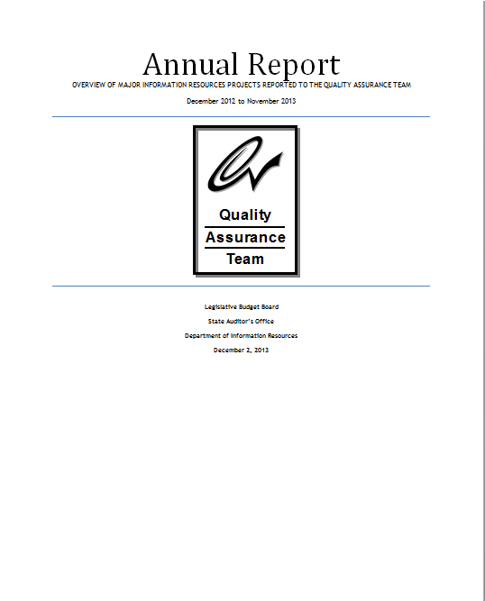
QAT Annual Report

Slide 23
Overview of QAT Projects
77 projects representing $1.8 billion in major information resources projects are in the QAT project portfolio.
Resource investments for MIRPs increased approximately $300 million from the 2012 QAT Annual Report.
13 projects were reported to be complete.
QAT reviewed approximately 54 new business cases submitted by 14 agencies.
Notes:
From Page 3 of QAT Annual Report. 54 new business cases were received in the last calendar year. Of these, 20 were approved.

Slide 24
Analysis of QAT Projects
57 projects in the technology portfolio began before September 2013
39 were late or projected to be late by an average of 24 months.
28 of the projects exceeded or are expected to exceed their initial budgets by an average of $8.9 million
34 projects reported to be more than one-third complete as of November 2013.
Notes:
SAO Report 13-028 and 12-047: Analysis of QAT Projects
Poor Planning
Vendor negotiations and bidding process delays
Legislative requirements change and/or requirements not well defined/scope changes
Turnover in project management and other key staff
Cost and timelines were underestimated
Lack of management support/stakeholder expectations not managed/priorities within agency changed
Project objectives and roles and responsibilities not clearly defined or understood

Slide 25
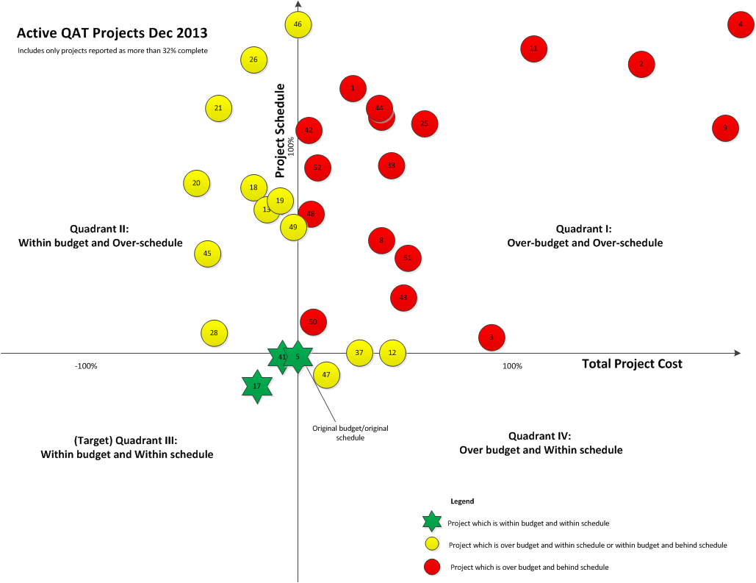
QAT Projects: Graphical Perspective Reported as more than 32% complete
Notes:
34 projects are reported to be more than 32 percent complete as of November 2013.
These projects have been mapped according to the percent of which they are over budget and/or over schedule.
Quadrant 1 shows 17 projects that are both over budget and over schedule.
Quadrant 2 shows 10 projects that are at or under budget but over schedule.
Quadrant 3 shows projects 3 projects that are at or under budget and on or under schedule.
Quadrant 4 shows 3 projects that are over budget but are on or under schedule.
One project is not mapped due to incomplete reporting (HHSC Enhanced Eligibility missing original end date).

Slide 26
Break!

Slide 27
QAT Projects Question 5:
As of December 2013, approximately how many active major information resource projects are being monitored by QAT?
27
47
77
107

Slide 28
QAT Projects Question 6:
As of December 2013, what is the estimated current costs for all QAT projects?
$563 million
$758 million
$1.3 billion
$1.8 billion

Slide 29
QAT Projects Question 7:
Approximately what percentage of active projects are NOT expected to meet their originally planned delivery schedules?
22%
42%
62%
82%

Slide 30
QAT Projects Question 8:
Approximately what percentage of active projects exceeded their initial budget/cost estimates?
22%
32%
42%
62%

Slide 31
Reasons for Overruns
Agencies identified the following reasons for overruns (taken from SAO Report 13-028: Analysis of QAT Projects)
Poor Planning
Vendor negotiations and bidding process delays
Legislative changes (scope changes)
Requirements not well defined
Turnover in project management and other key staff
Cost and timelines were underestimated
Lack of management support/stakeholder expectations not managed/priorities within agency changed
Project objectives and roles and responsibilities not clearly defined or understood

Slide 32
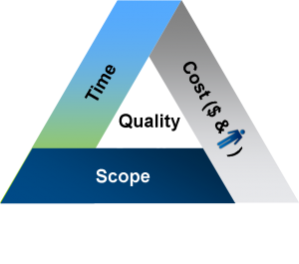
Triple Constraint: Challenges with Maintaining Equilibrium

Slide 33
Factors Contributing to Project Success
Active agency staff involvement in planning, scope management, requirements gathering and user acceptance activities.
Fostering an environment of open/collaborative communication.
Effective management support.
Shorter project timelines.
Phased or iterative approach.
Focusing on business outcomes.
Modified commercial-off-the-shelf software.
Following contract development best practices (e.g. early involvement of procurement, contract, IT, legal, and program area staff)
Monitoring contractor performance and understanding that it is a mutual relationship

Slide 34
QAT Observations
Agencies are beginning to break larger projects into smaller, more manageable projects using a phased approach when they develop and implement major information resources projects.
Based on QAT data, it appears that the phased approach results in more successful project outcomes with realistic initial estimates of costs and time lines.
Of the 20 new approved projects, only 3 exceed 2 years in estimated development time.
Some projects that used a commercial off-the-shelf solution as a beginning point for their development had better budgetary and delivery outcomes than projects that did not use a similar approach.

Slide 35
Office of Attorney General Crime Victims Claims Legacy Workflow System
Project was successful because:
The project scope was clear and did not expand.
The OAG identified and properly categorized system requirements.
The project had strong executive sponsorship.
The project identified and included the correct subject matter experts.
Outcome:
The project was recognized by the Texas Association of State Systems for Computing and Communications for implementing a technical application significantly improving internal operations, customer services, or communications.
Notes:
Note how this project applied many of the factors mentioned in ‘Factors Contributing to Project Success’ slide.

Slide 36
New Legislation
H.B. 1965
Requires QAT to develop and recommend policies and procedures to improve state agency IT projects and develop and recommend procedures to improve the implementation of state agency IT projects
H.B. 2422
Authorizes state agencies to consider cloud computing when making a major IT purchase
H.B. 3093
Requires DIR to work with QAT and LBB to develop contracting standards for IT acquisition. Also requires development of policies and procedures for improved efficiency and effectiveness of IT projects
S.B. 1681
Increases CAT review threshold to at least $10 million; QAT review threshold remains $1 million
Notes:
Discuss Impact for each bill

Slide 37
New Legislation Continued: S.B. 1
S.B. 1 Article IX, Section 9.02
QAT must approve projects before the Comptroller can authorize expenditure of appropriated funds.
QAT can require independent verification and validation for projects projected to result in more than $10 million in overall lifetime expenditures.

Slide 38
Break!

Slide 39
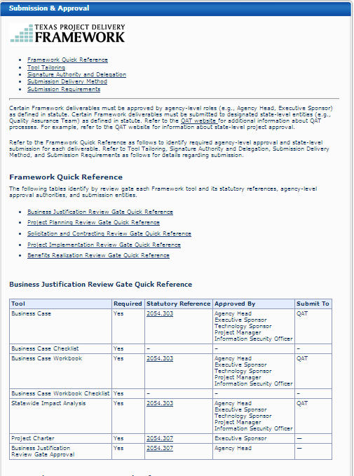
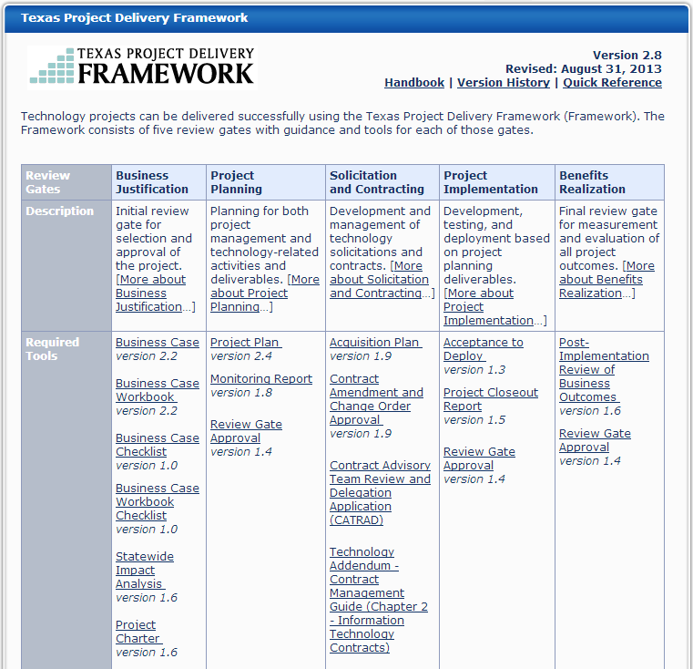
Framework

Slide 40
Texas Project Delivery Framework (Framework)
Helps agencies deliver MIRPs on-time and within scope/budget by providing project management resources (templates and instructions).
Provides a consistent way for agencies to report project status and other project information to the Quality Assurance Team (QAT).
Ensures that business needs and outcomes are placed ahead of technology.
Required for MIRPs.
Only effective when combined
with PM and SDLC methods.
In a nutshell, the Framework is a….
-Guidance and a
-Toolset
For IR Projects and Contracts.
Notes:
Texas Government Code 2054 requires agencies to use the Texas Project Delivery Framework (Framework) for major information resource projects (MIRPs) and certain major contracts.

Slide 41
Framework: Getting Started
Begin the Business Case and Statewide Impact Analysis when the Legislative Appropriations Request (LAR) is developed.
Use the Framework Quick Reference Webpage and the long-form instructions to get started.
Follow the submission requirements in the Framework Handbook.
Use the Business Case and Workbook Checklists.
Notes:
Texas Government Code 2054 requires agencies to use the Texas Project Delivery Framework (Framework) for major information resource projects (MIRPs) and certain major contracts.

Slide 42
Some best practices for completing Framework deliverables
Define methods for quantifying project costs and benefits.
Use long-form instructions when completing Framework deliverables.
Leverage Request for Information (RFI) to help scope the project.
Involve the IT, Business Line, Purchasing, and Legal departments in the acquisition planning process.
Consistency of information across deliverables.
The initial project costs given in the Monitoring Report should equal the total Business Case Costs for development and implementation (excludes maintenance costs).
Keep the lines of communication open with QAT.

Slide 43
Please note…
QAT must have the Business Case, Statewide Impact Analysis (SIA), Acquisition Plan, and Project Plan on file for each MIRP before solicitation can be posted
During project implementation, if it is discovered that changes cause the total project cost to exceed the previous baseline by 10% or more, the Business Case must be resubmitted to QAT
Recommend that SIA and Project Plan be updated
If a contract amendment or change order increases the original contract amount by 10% or more, the agency must submit the contract amendment and change order deliverable to QAT (until then, any amendments or change orders will be considered void)
Notes:
They cannot sign the contract until they have approval from QAT.

Slide 44
QAT Observations From Proposed Business Cases
Many projects are initially being submitted without a full methodology of benefits having been quantified.
Some projects were actually programs, which are collections of several projects. Framework instructions provides guidance on how they should separate out the technology projects that are related to a program.
Agencies did not always provide a methodology to quantify costs in their project deliverables.
Notes:
From bullets on page 6 of QAT Annual Report.
Below is a summary of QAT’s significant observations during the review of the proposed business cases:
Many projects are initially being submitted without a full methodology of benefits having been quantified. In addition, agencies did not always provide a methodology to quantify costs in their project deliverables. QAT met with agencies on multiple occasions to discuss their projects’ quantitative benefits section while DIR assisted them in providing sample methodologies that other agencies have used in their quantitative benefits section.
Agencies have communicated to QAT that they are reluctant to quantify benefits associated with the reduction in staff. Agencies are concerned with having their full time equivalent count reduced if they tie efficiencies gained through the implementation of a new system to staffing.
QAT identified a project at the Texas Education Agency that is using another related project as a financial placeholder. That can cause a lack of clarity in accountability for business outcomes.
Some agencies indicate that they do not have enough qualified internal staff to develop a project. They typically must hire additional staff or outsource project development to a vendor. Agencies then use internal staff to oversee a vendor’s project manager.
While reviewing multiple project deliverables at some agencies, QAT noted that some projects were actually programs, which are collections of several projects. DIR’s framework is intended to apply only to projects. QAT met with these agencies and referred them to the framework instructions which provides guidance on how they should separate out the technology projects that are related to a program.

Slide 45
Framework Redesign Project
An interagency Work Group has been formed to evaluate and implement comprehensive changes to the Framework
A Draft Project Plan has been developed and is currently being reviewed by stakeholders
Current Change Advisory Board processes are not designed to address a holistic, comprehensive set of changes
The Framework should be
Streamlined
User- friendly,
More aligned with changing trends in how information technology projects are delivered (e.g. Agile development methodologies and web-based submissions of deliverables)

Slide 46
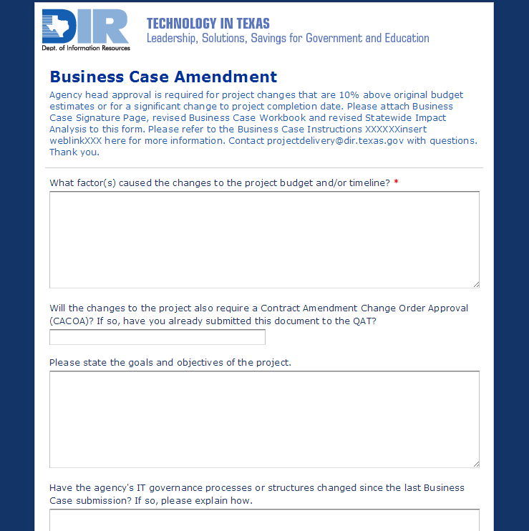
PROPOSED Streamlined Submission

Slide 47
TENTATIVE Framework Redesign Milestone Schedule
Milestone/Deliverable* | Target Date
Distribution of draft Project Plan and background information to stakeholders for review | 11/21/2013
Kick-off meeting with stakeholders to review Project Plan, scope, and next steps | 12/11/2013
Version 1.0 of Project Plan | 1/10/2014
Work breakdown structure, schedule, and assignment of resources to tasks (draft) | 1/24/2014
Deliverable: Statewide Impact Analysis revisions | 3/28/2014
Deliverable: Business Case Amendment | 4/25/2014
Deliverable: Framework web page revisions (rewording and reorganization) | 8/29/2014
*Deliverables and dates may change pending feedback from stakeholders.

Slide 48
Framework Redesign Project: Tentative Plan
Statewide Impact Analysis revisions
EIR Accessibility checklist
Single web page containing required templates
Planning Activities
NOV DEC JAN FEB MAR APR MAY JUN JUL
2014
ROI calculation and other revisions to Workbook
Business Case Amendment
Cloud services checklist
Additional Framework web page revisions (rewording and reorganization)
SDLC checklists and other SDLC Template modifications
AUG SEP OCT NOV DEC
Earned value calculations feasibility assessment
Project Delivery Templates, Handbook, and Instruction revisions
Procurement checklist
Alignment of Review Gates with PMBOK processes
48
Notes:
Framework Redesign Project: Tentative Plan
2013
November and December: Planning Activities
2014
February: ROI calculation and other revisions to Workbook
March: Statewide Impact Analysis revisions
April: Business Case Amendment
May: EIR Accessibility checklist
June: Cloud services checklist
July: Single webpage containing required templates
August: Earned value calculations feasibility assessment
September: Project Delivery Templates, Handbook, and Instruction revisions
November: Alignment of Review Gates with PMBOK processes
December: Procurement checklist

Slide 49
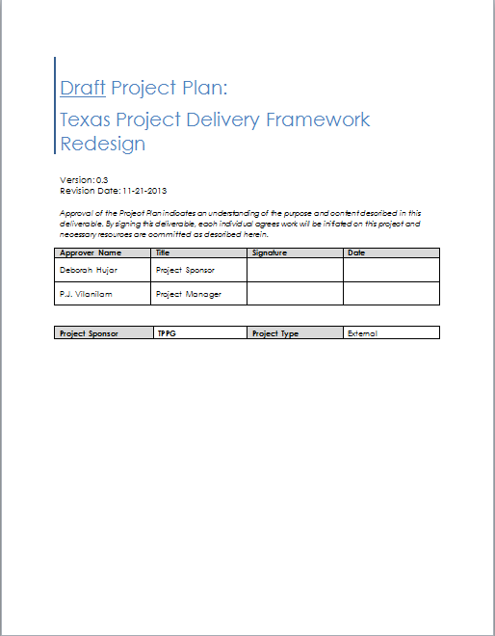
Framework Redesign Project Plan

Slide 50
What can we do to improve project outcomes?
Use the Framework
Manage your scope
Communicate with QAT (esp. if there are grey areas)
Follow guidelines in 1TAC 216
Follow contract development best practices
Monitor contractors and understand that it is a mutual relationship
Be realistic in your expectations
Define project timeline and budget based on solutions that will solve business problems

Slide 51
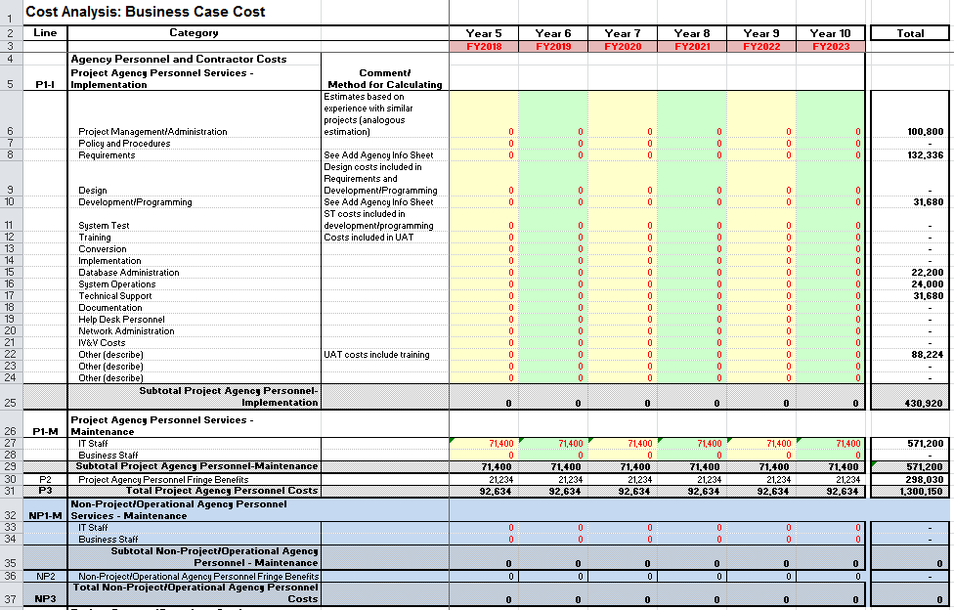
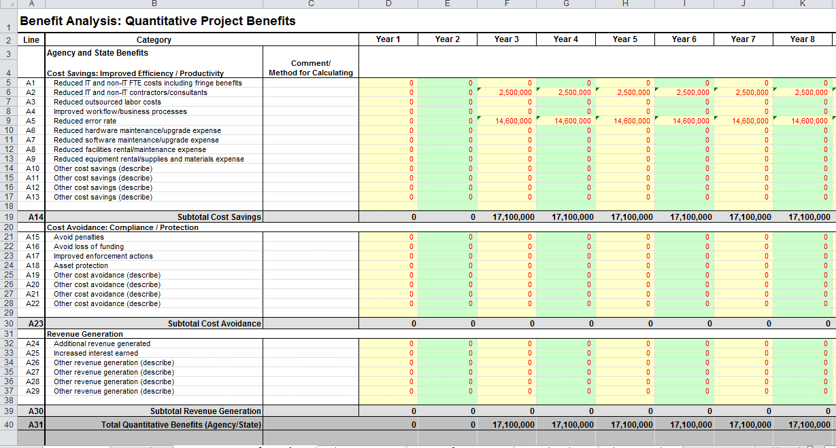
Interactive Session: Business Case Workbook

Slide 52
References
Contact Information for General Questions
projectdelivery@dir.texas.gov
Quick Reference (What’s Required to be Submitted to QAT?)
Framework Quick Reference Link
What is the Statewide Project Delivery Program?
Statewide Project Delivery Program Link
Where can I Find More Information about QAT?
Link to QAT Publications Website
Where can I find more information about CAT?
Link to CAT Website

